Slide 1
Spacecraft Sensors with NASA Data
ERDŐS INSTITUTE DATA SCIENCE BOOT CAMP
Diego Rios, Juan Orellana, Rithwik Susheel Vidyarthi, Henry Fontana, Jezerca Hodaj
P-1 spacecraft telemetry

Slide 2
PROJECT OVERVIEW
Introduction
Anomalies in time series data
The goal of our project is to evaluate various methods for identifying anomalous behavior in time series data, in particular we evaluate the cost of implementing different models.
Forecasting
Given non anomalous data we train models to predict future values
  We have presplit telemetry data from 82 different channels (power,radiation,temperature), the training data contains no anomalies.
We use these models together with a prebuilt detection module to flag anomalous intervals.
Cost Evaluation
Finally we compare the cost of running our detection models.
P-1 spacecraft telemetry • Erdős Institute Data Science Boot Camp

Slide 3
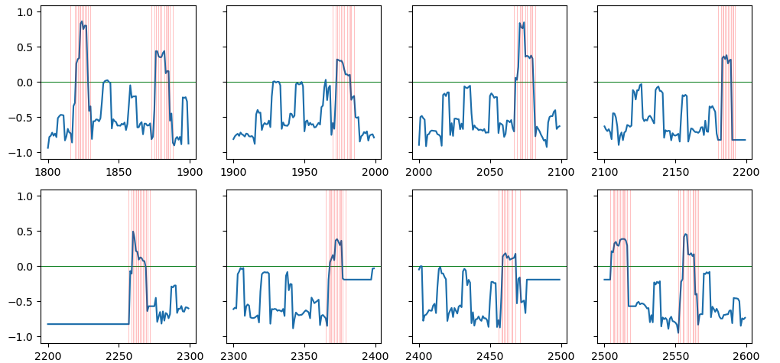
P-1 Telemetry Features
DATASET
The data set has different telemetry channels and each channel has its specific features.
We work on the P-1 channel, which other than its telemetry values it also contains 24 features which are binary, 0 means this feature is inactive while 1 means this feature is active.
  The figure above shows how our telemetry values changes over time and the red vertical lines indicate when at least one of the features active and how it affects the telemetry readings.
P-1 spacecraft telemetry • Erdős Institute Data Science Boot Camp

Slide 4
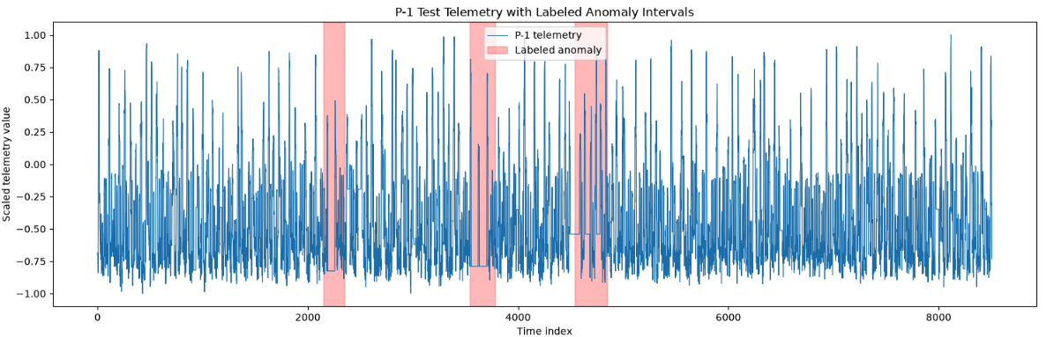
Anomalies on P1
DATASET
Our data set has two different types of anomalies:
Contextual (long intervals where the telementray values are constant)
Point (a spike on the telemetry values on a timestep)
On P-1, there are three contextual anomalies occurring on
[2149, 2349], [3539, 3779], [4536,4844]
P-1 spacecraft telemetry • Erdős Institute Data Science Boot Camp

Slide 5
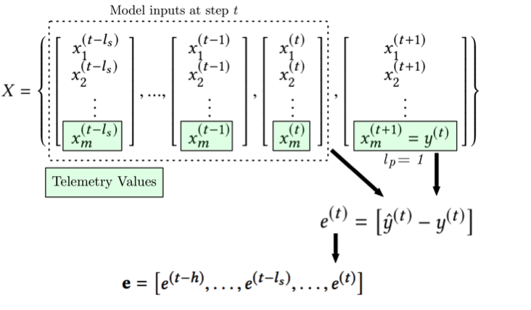
LSTM Forecasting
FORECASTING
The original paper uses LSTM to forecast future telemetry values.
They choose a history window of 250 time steps, and input the telemetry values as well as the features to predict the next telemetry value.
They analyze the prediction error and determine a determine a threshold to detect anomalies.
P-1 spacecraft telemetry • Erdős Institute Data Science Boot Camp

Slide 6
WHY MULTIPLE MODELS?
Modeling approaches
Forecast → error → anomaly alert
Direct detection
Predict telemetry, then flag unexpected forecast errors.
One-Class SVM
Simple forecasting
Naive · Rolling average
Learns patterns of normal behavior
Linear methods
Ridge · ARX(1)
Rolling median / MAD*
Nonlinear methods
KNN · Random Forest
(250-step / 5-lag)
Robust local deviations in raw telemetry
Reference: Published LSTM forecasts
* Other exploratory statistical baselines: global/rolling z-scores, robust z-score and empirical rank.
1 / 3
P-1 spacecraft telemetry • Erdős Institute Data Science Boot Camp

Slide 7
EVENT-LEVEL COVERAGE
Which P-1 anomaly events were detected?
Detected means at least one alert overlapped the labeled event.
Model
EVENT 1
EVENT 2
EVENT 3
2149–2349
3539–3779
4536–4844
Naive
✓ Detected
— Missed
— Missed
Ridge
— Missed
— Missed
✓ Detected
Autoreg w/ Exogenous
— Missed
— Missed
✓ Detected
Random Forest (5 lags)
✓ Detected
✓ Detected
— Missed
KNN
— Missed
✓ Detected
✓ Detected
Random Forest (250 steps)
✓ Detected
— Missed
✓ Detected
Published LSTM
✓ Detected
✓ Detected
✓ Detected
One-Class SVM*
✓ Detected
✓ Detected
✓ Detected
Rolling median/MAD (60)†
✓ Detected
✓ Detected
✓ Detected
* SVM: separate flag merging. † Rolling median/MAD: exploratory, telemetry-only; 60-point window explored on P-1.
Models use different anomaly-detection procedures; comparisons should be interpreted cautiously.
P-1 spacecraft telemetry • Erdős Institute Data Science Boot Camp
2 / 3

Slide 8
EVENT-LEVEL ANOMALY DETECTION PERFORMANCE
Precision, Recall, F1 Score and False Alerts
Precision measures false-alert burden; recall measures how many labeled anomalies were detected.
Model
Precision
Recall
F1
False alerts
Naive
100%
33%
0.50
0
Ridge
100%
33%
0.50
0
Autoreg w/ Exogenous inputs
100%
33%
0.50
0
Random Forest (5 lags)
100%
67%
0.80
0
KNN
100%
67%
0.80
0
Random Forest (250 steps)
67%
67%
0.67
1
Published LSTM
75%
100%
0.86
1
One-Class SVM*
60%
100%
0.75
2
Rolling median/MAD (60)†
100%
100%
1.00
0
† Rolling median/MAD results are exploratory; Window choice was exploratory.
Event-level scoring: Each labeled anomaly is counted once, regardless of how many overlapping alerts a model generates.
3 / 3
P-1 spacecraft telemetry • Erdős Institute Data Science Boot Camp

Slide 9
Computational Cost Estimates
COST EVALUATION
We utilize Amazon’s Web Services (AWS), a cloud computing platform, to estimate computing expenses using published pricing rates
The following results assume:
A single CPU
2 Gigabytes of memory
Assumed daily workload: Starts one cloud task, allow 30 seconds for startup, process 1,000 batches of 8,245 forecast targets each, shuts down, repeat for 30 days.
The monthly computing expense for each model is $35.55, we report the daily cost estimate for each model leading up to this value
P-1 spacecraft telemetry • Erdős Institute Data Science Boot Camp

Slide 10
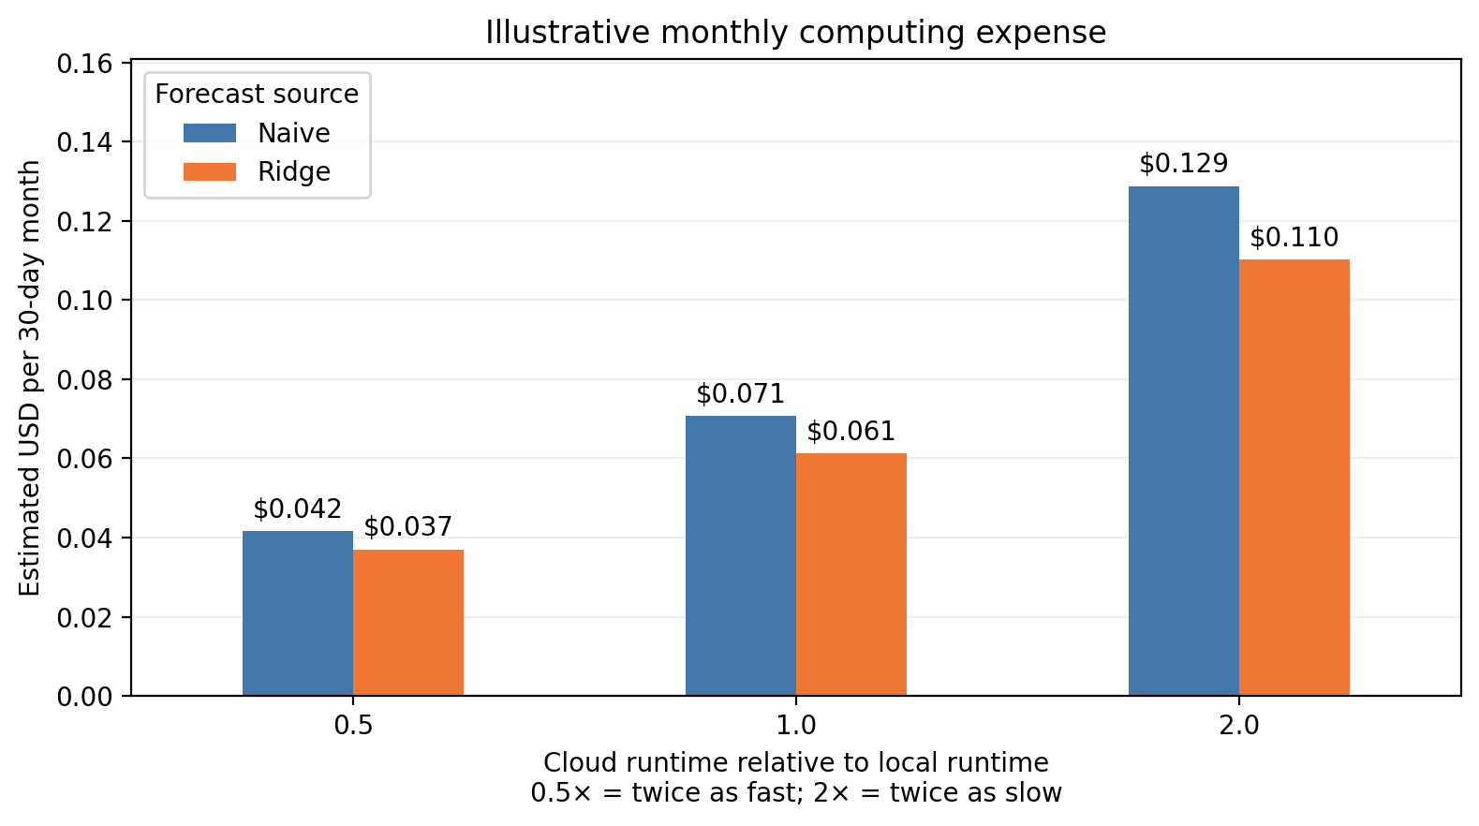
Naive vs. Ridge
COMPUTATIONAL COST ESTIMATES
Because we did not run the code directly on AWS, the graph shows three scenarios. Cloud processing assuming
Half as long as local benchmark
Same as local benchmark
Twice as long
P-1 spacecraft telemetry • Erdős Institute Data Science Boot Camp

Slide 11
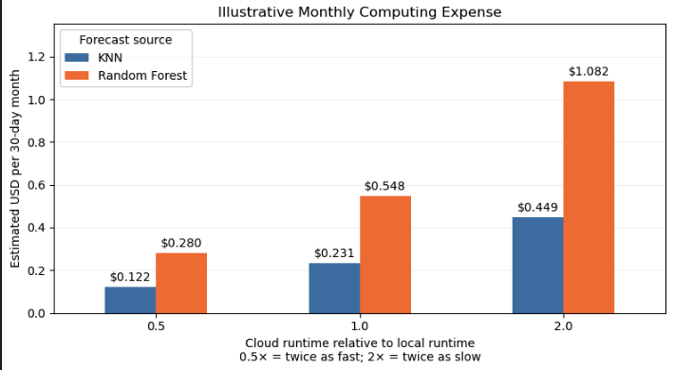
KNN vs. Random Forest
COMPUTATIONAL COST ESTIMATES
P-1 spacecraft telemetry • Erdős Institute Data Science Boot Camp

Slide 12
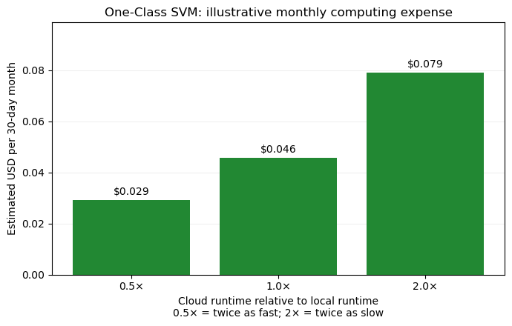
One-Class SVM
COMPUTATIONAL COST ESTIMATES
P-1 spacecraft telemetry • Erdős Institute Data Science Boot Camp

Slide 13
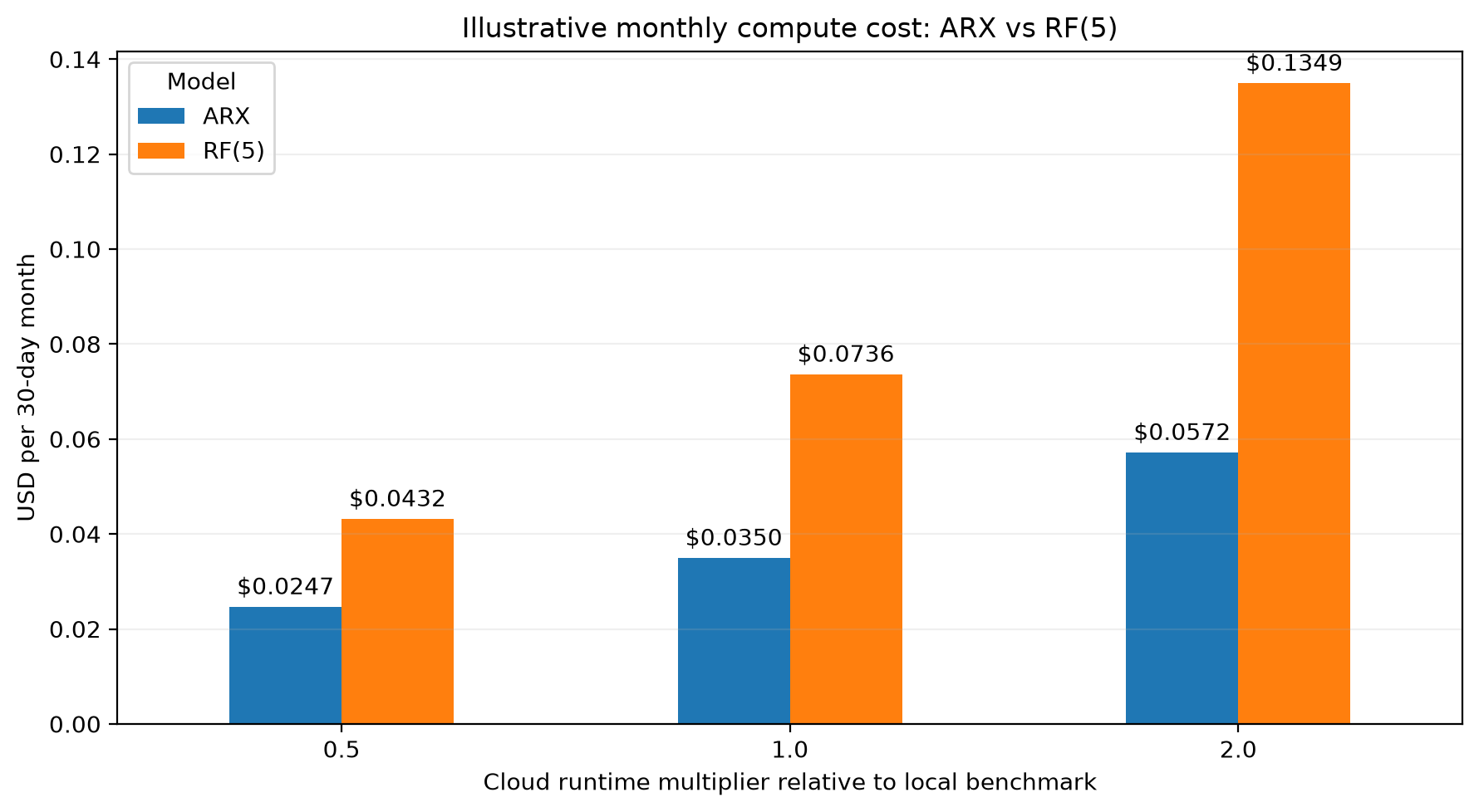
Auto Register vs. Random Forest
COMPUTATIONAL COST ESTIMATE
P-1 spacecraft telemetry • Erdős Institute Data Science Boot Camp

Slide 14
Future Directions
NEXT STEPS
Using the other channels available in the dataset.
-How well do the models generalize to models in the same group e.g. P-2 , P-3 etc.
-How well do they generalize to model in different groups like T-1, R-1 etc.
Using a classification model
-Build a classifier model on dataset with labelled anomalies
Try to fit models on data from ESA
-OPS-SAT-AD : actual timestamps, channel descriptions
-ESA-ADB : Supports multi-channel analysis
P-1 spacecraft telemetry • Erdős Institute Data Science Boot Camp

